Slide 1


One Health is an effort for bringing remote/needy people & Healthcare Organizations under one roof

Slide 2

HEALTHCARE
There are a lot of different health problems in the poor(rural) areas than in cities and towns. At times when it comes to get proper health care for the major diseases, the people in the poor(rural) areas lack those benefits. In this condition to get good health care people need to travel to cities. And sometimes it happens that patient cannot reach hospital on time. Thus, there is a serious need of the non-profit hospitals and organizations in the poor(rural) areas.

Slide 3

Available Services
Available Services
Free Consulting Services
Free Equipment
Low Cost Medicines
Blood Bank Support
Employment

Slide 4
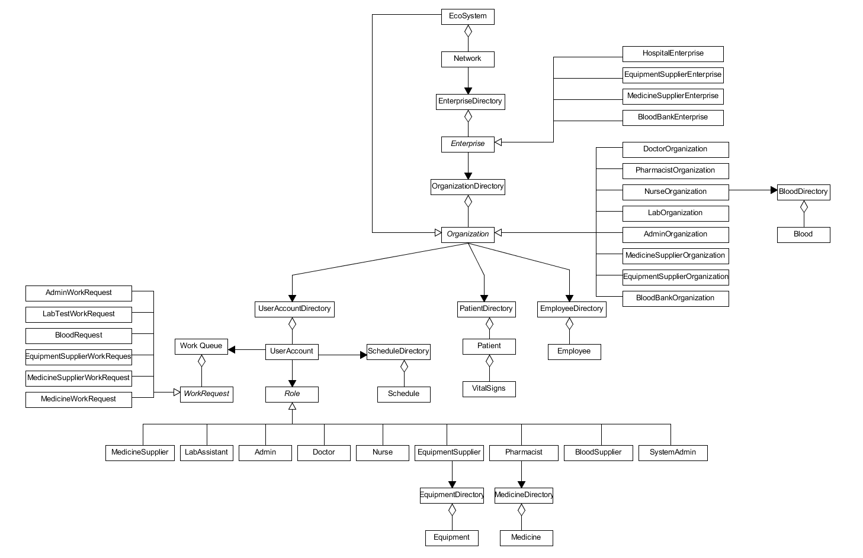
Eco-System Model

Slide 5
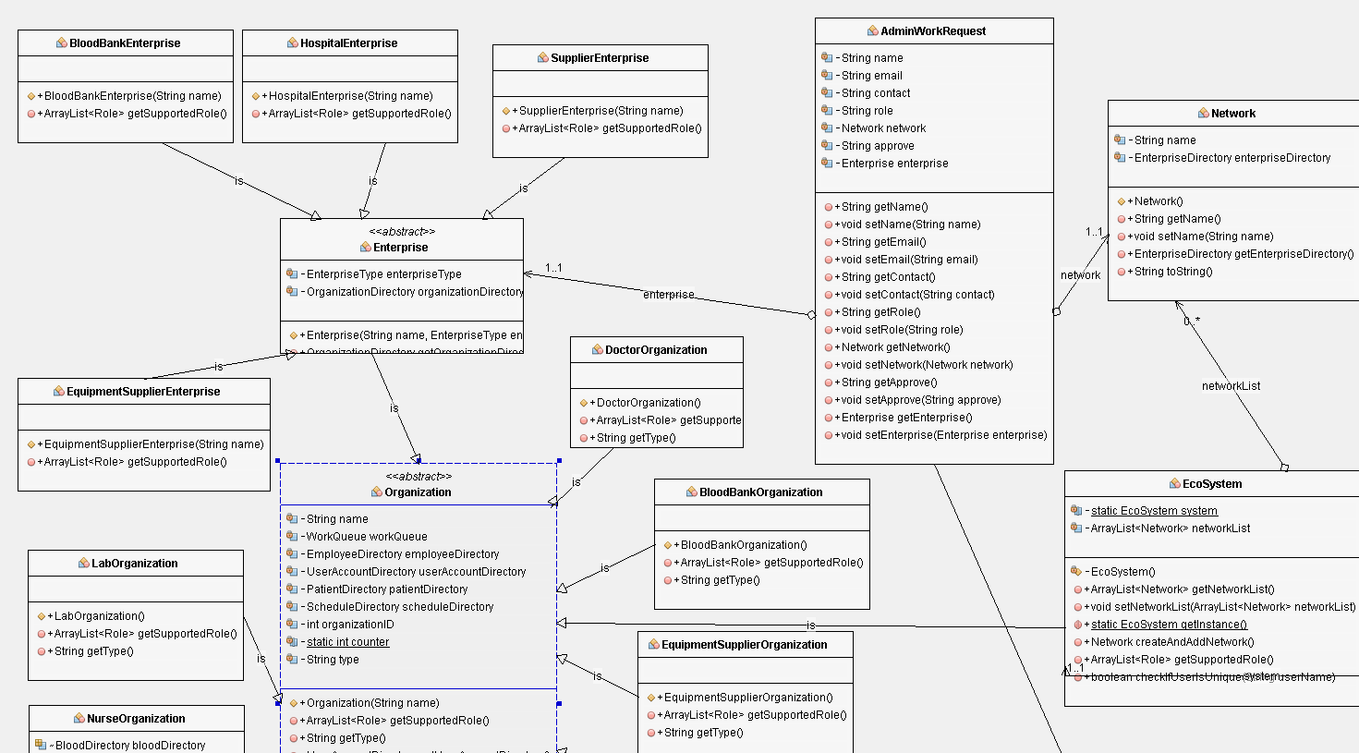
UML Diagram

Slide 6
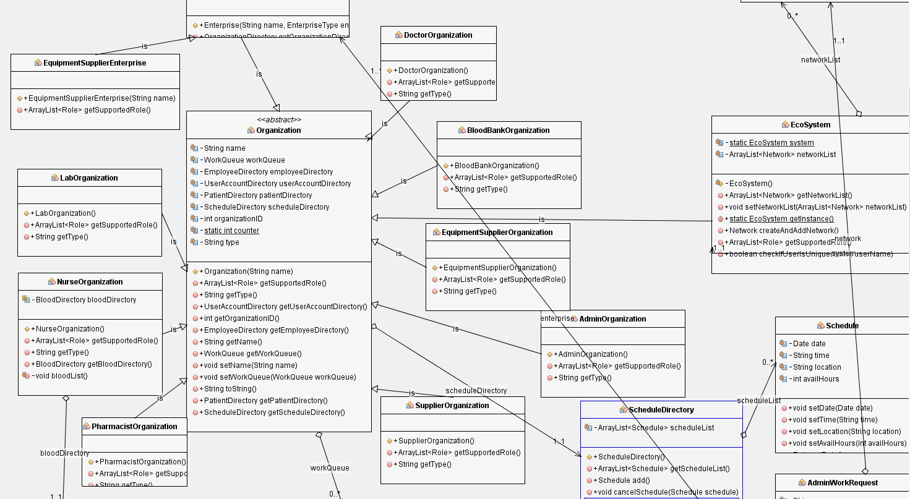

Slide 7
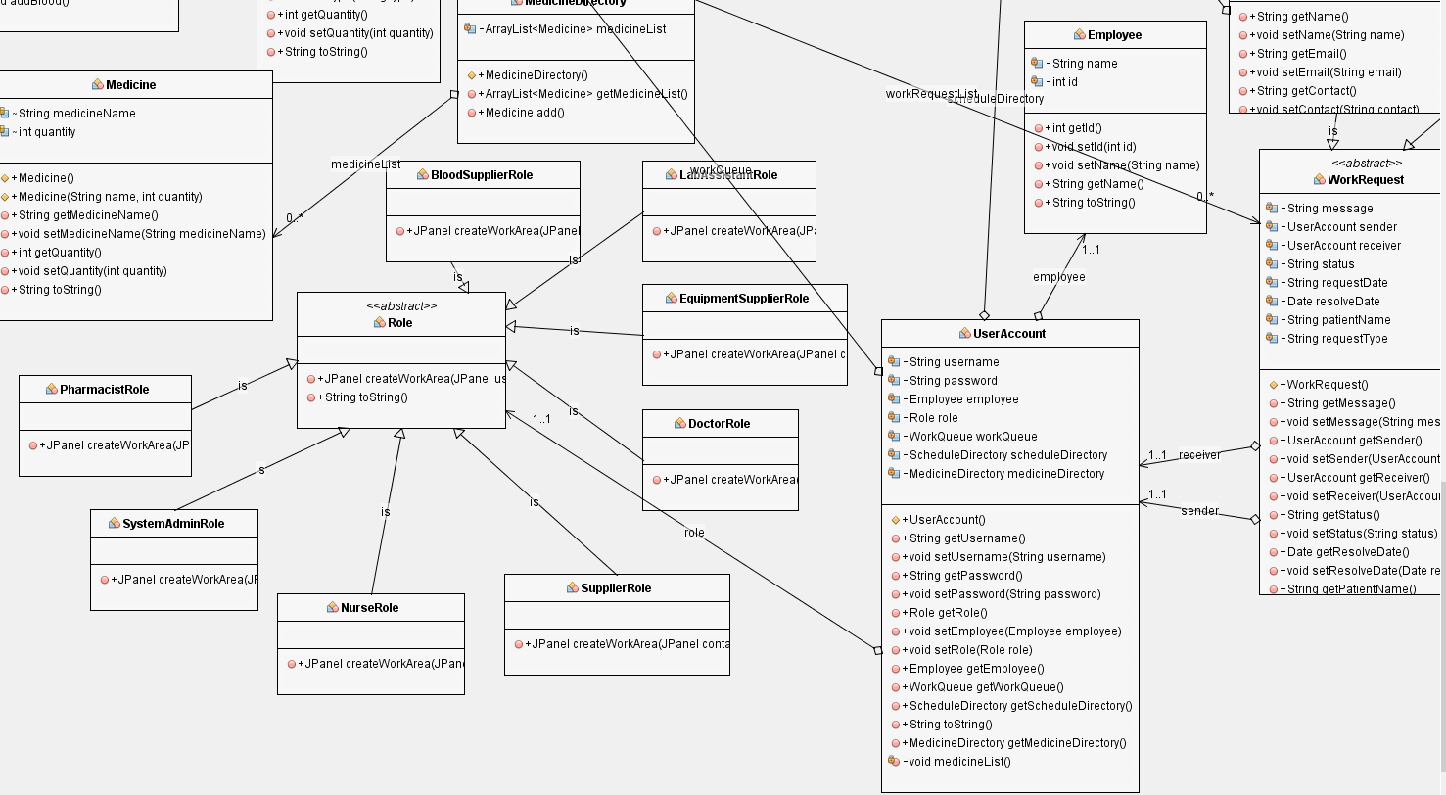

Slide 8
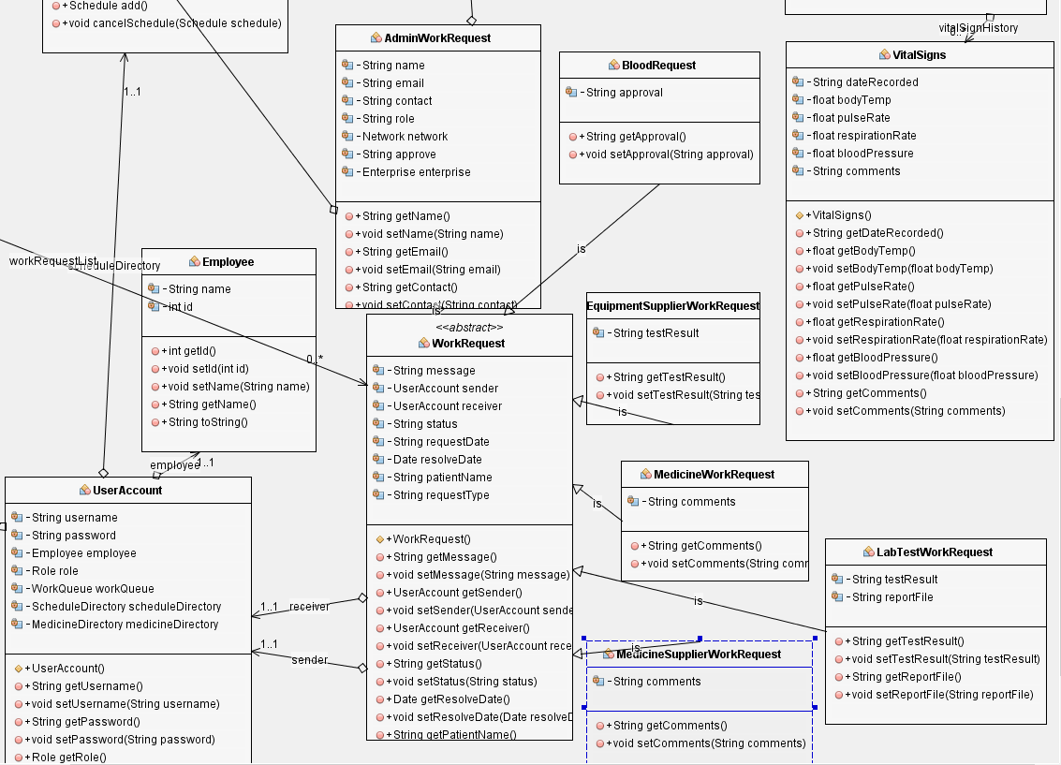

Slide 9
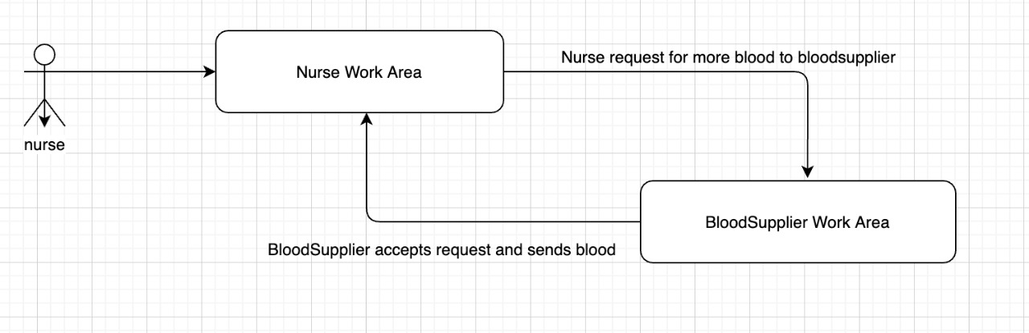
Work Flow(Nurse to blood organization)
From Hospital enterprise a nurse request for more blood this request Is then send to a blood bank enterprise where the blood bank employee accepts the request and processes the required blood back to the hospital where the nurse accepts, and this completes a work request between two employees of different enterprise.

Slide 10
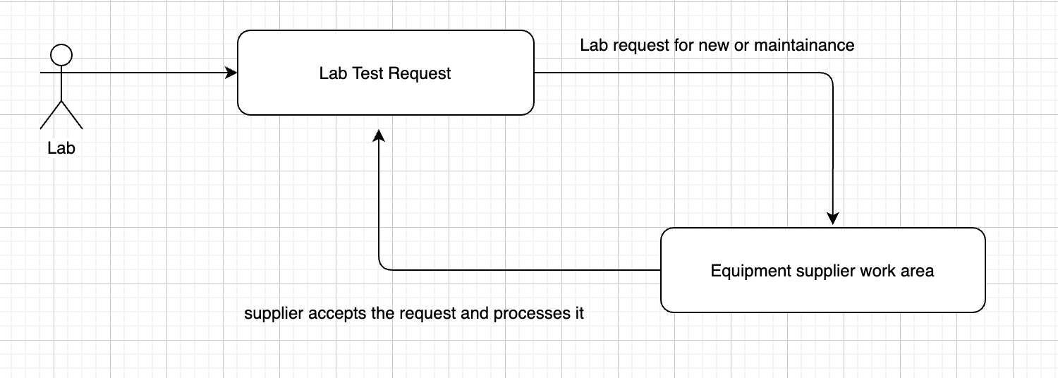
Work Flow(Lab to equipment organization)
A lab assistant request for a new equipment or maintenance of an old equipment from hospital enterprise this request goes to equipment supplier enterprise where the equipment supplier accepts the request and processes the required equipment back to hospitals lab organization where the lab assistant accepts it.

Slide 11

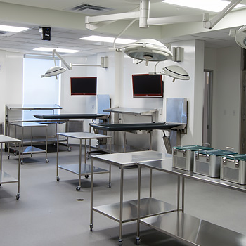

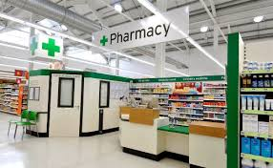
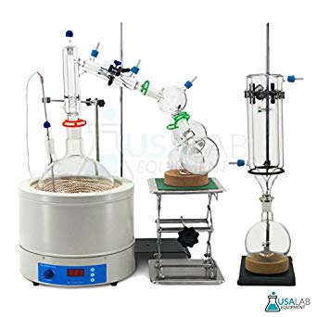
Organizations
Hospital
Lab
Blood Bank
Pharmacy
Equipment

Slide 12


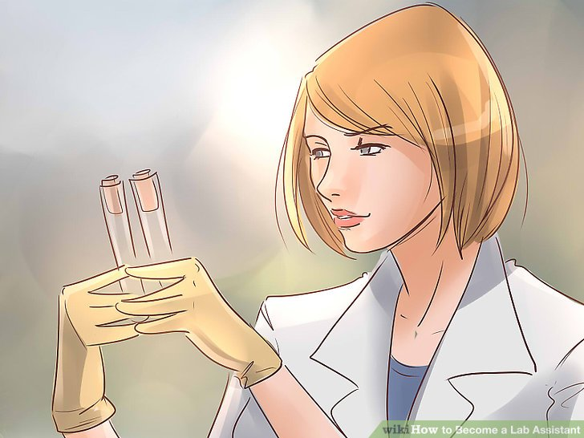


Roles
Doctor
Nurse
Lab Assistant
Blood Supplier
Pharmacists

Slide 13
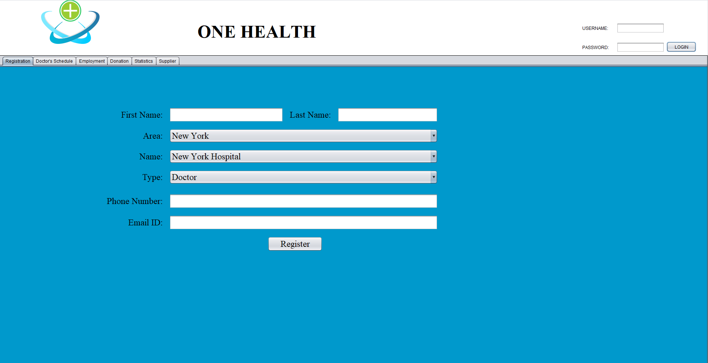

Slide 14



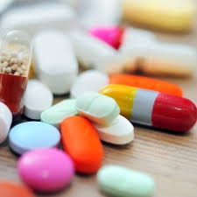
Doctors
Free Service
Schedule
Medicine request for patient
Doctors provide free services to patients.
Doctors set their available time
Doctors request medicines for patients after diagnosing their diseases

Slide 15
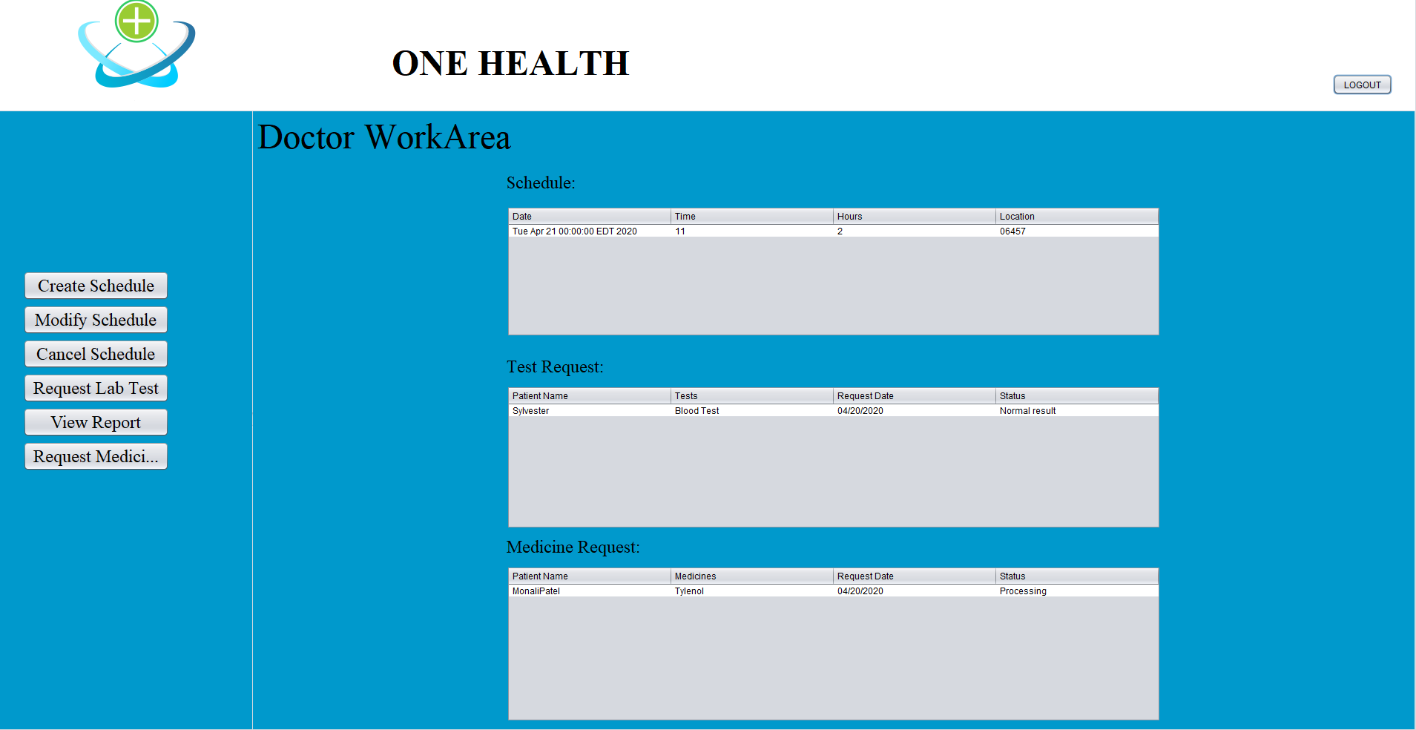

Slide 16
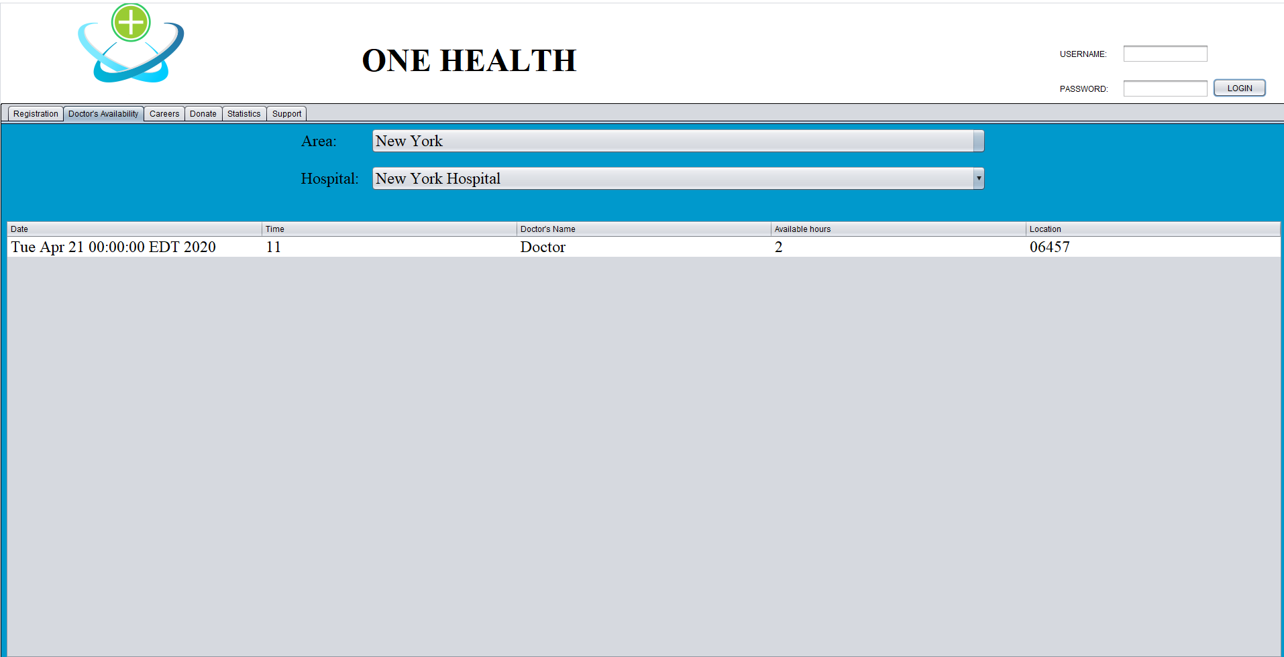

Slide 17
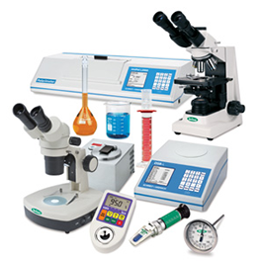
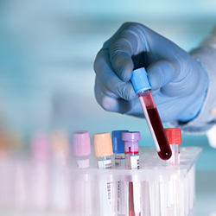
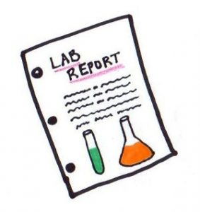
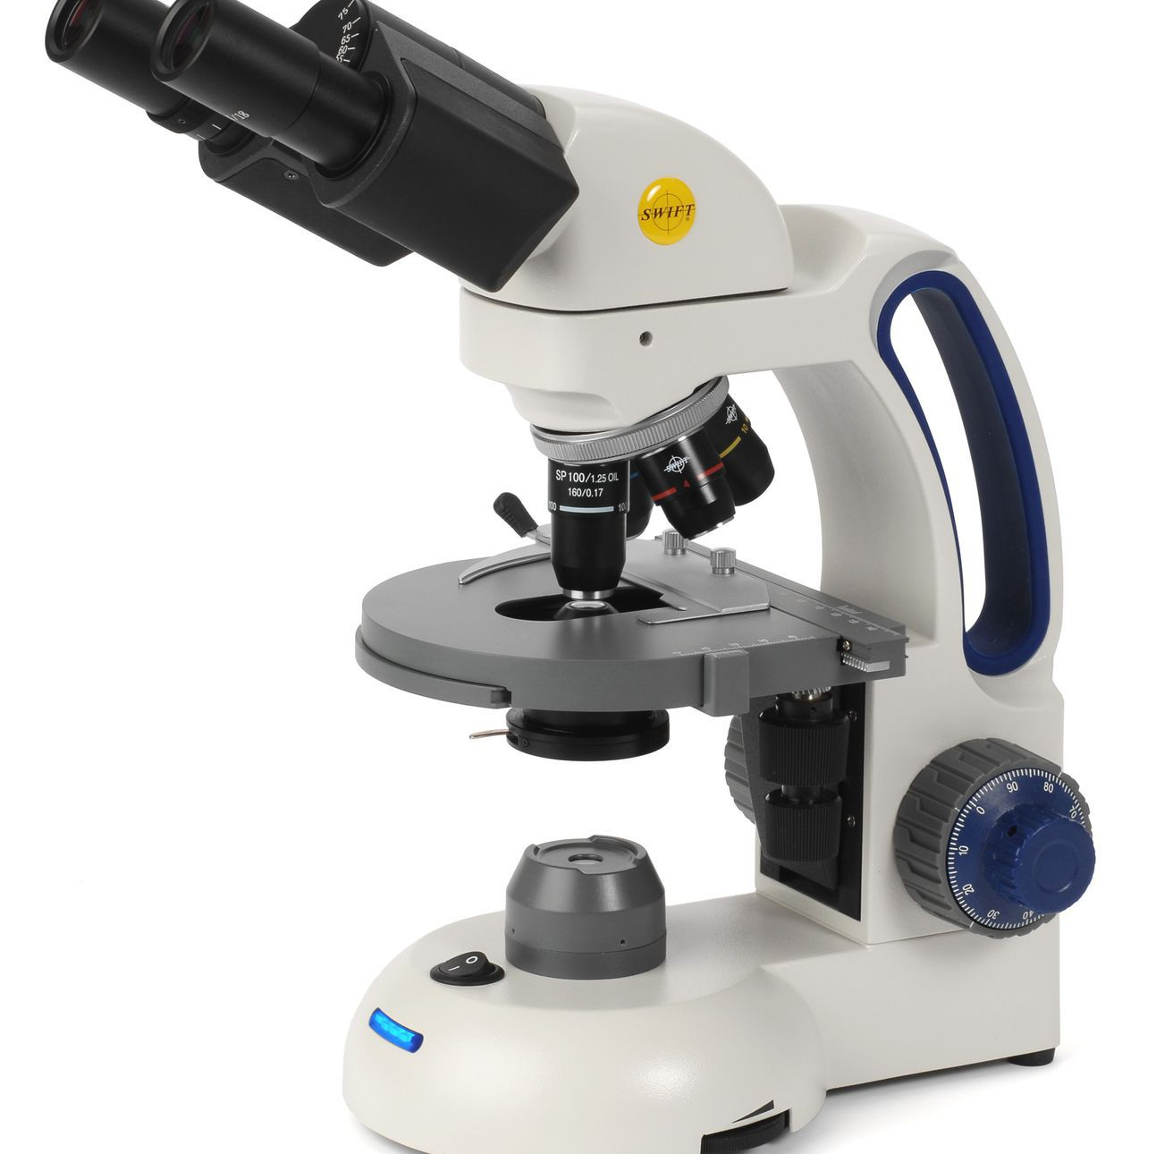

Lab Assistant
Lab Test
Upload Reports
Perform Tests on patients as requested by Doctors .
Upload test reports of patients so that Doctors can view and give prescriptions accordingly.
New Equipment Request
Equipment Maintenance Request
To request for new equipment for the lab.
To request for the maintenance of the available equipment.

Slide 18
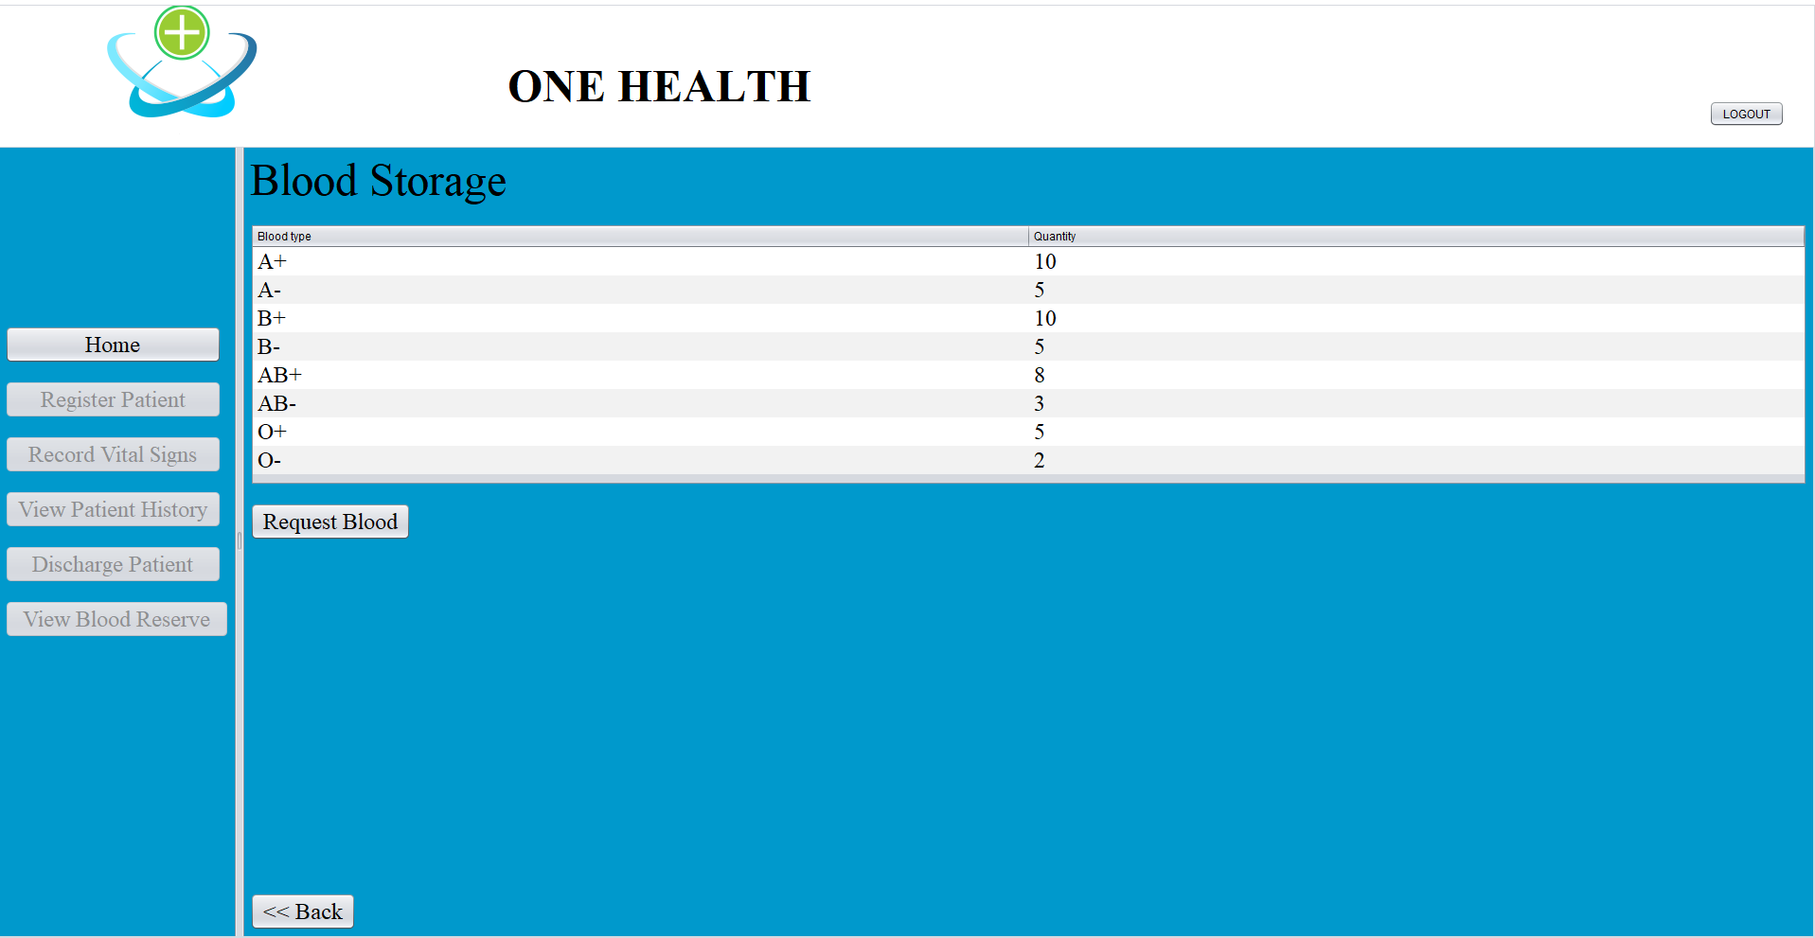

Slide 19

Pharmacist
Process Medicine Request from Doctor
Manage medicine Inventory
Request Medicine Supply to Pharmaceuticals

Slide 20
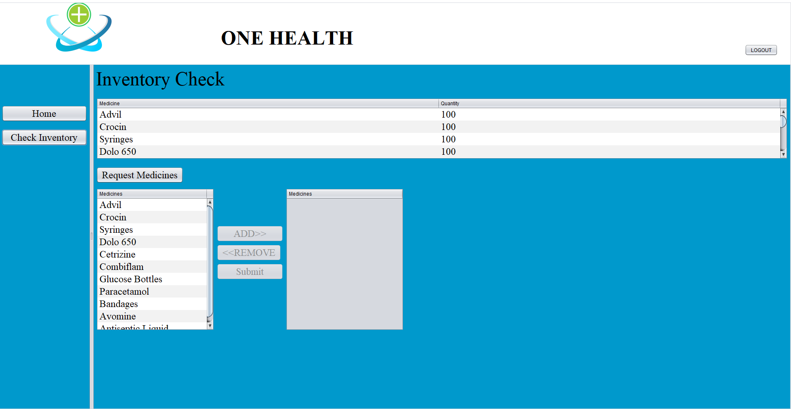

Slide 21

Nurse
Register Patient
Record Vital signs
Maintain patient this history
Request for blood to Blood bank

Slide 22
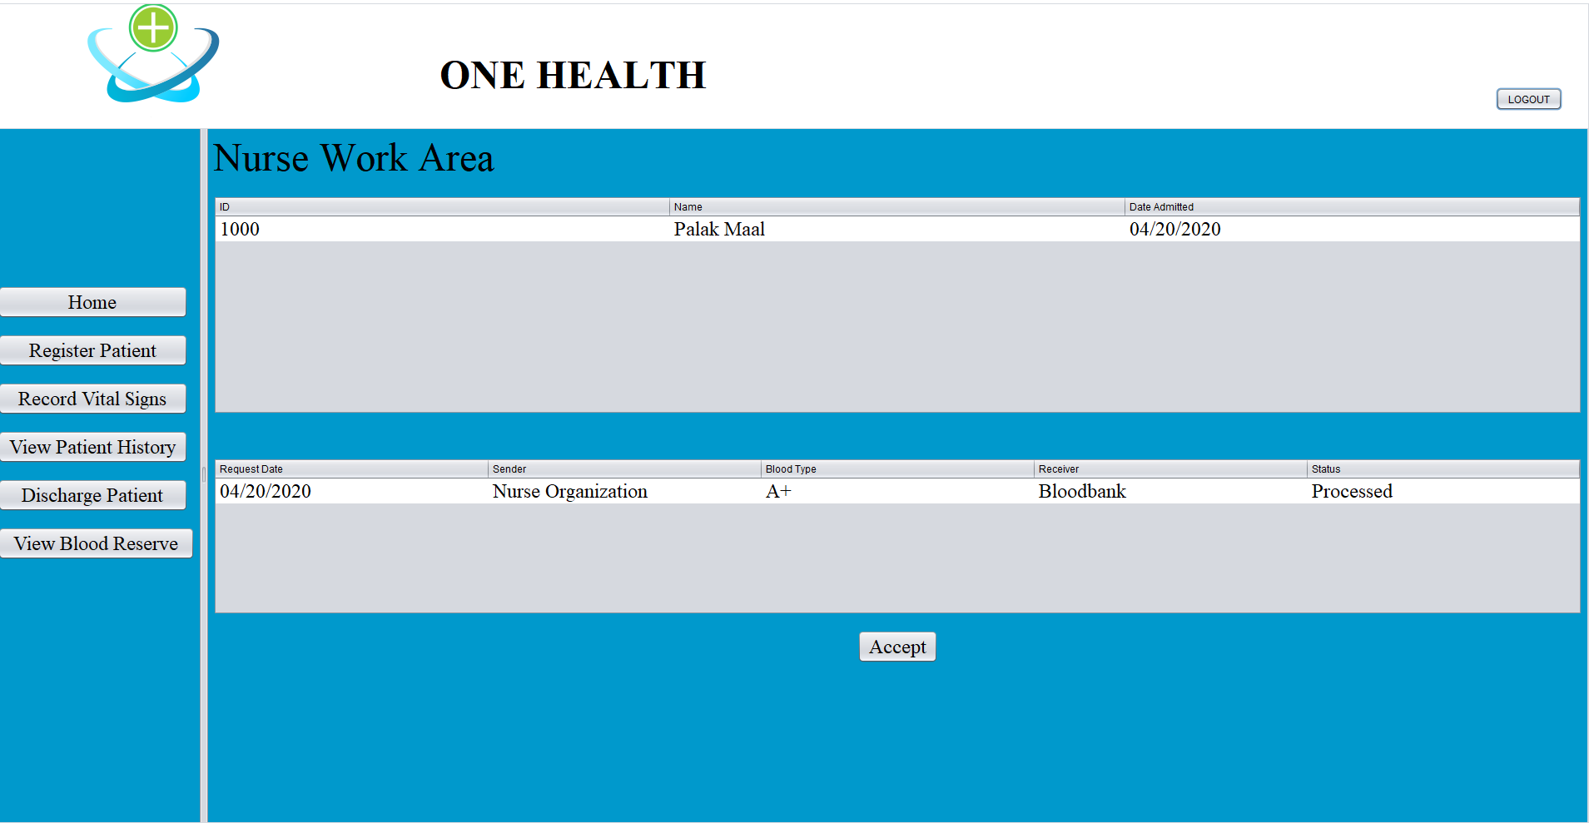

Slide 23
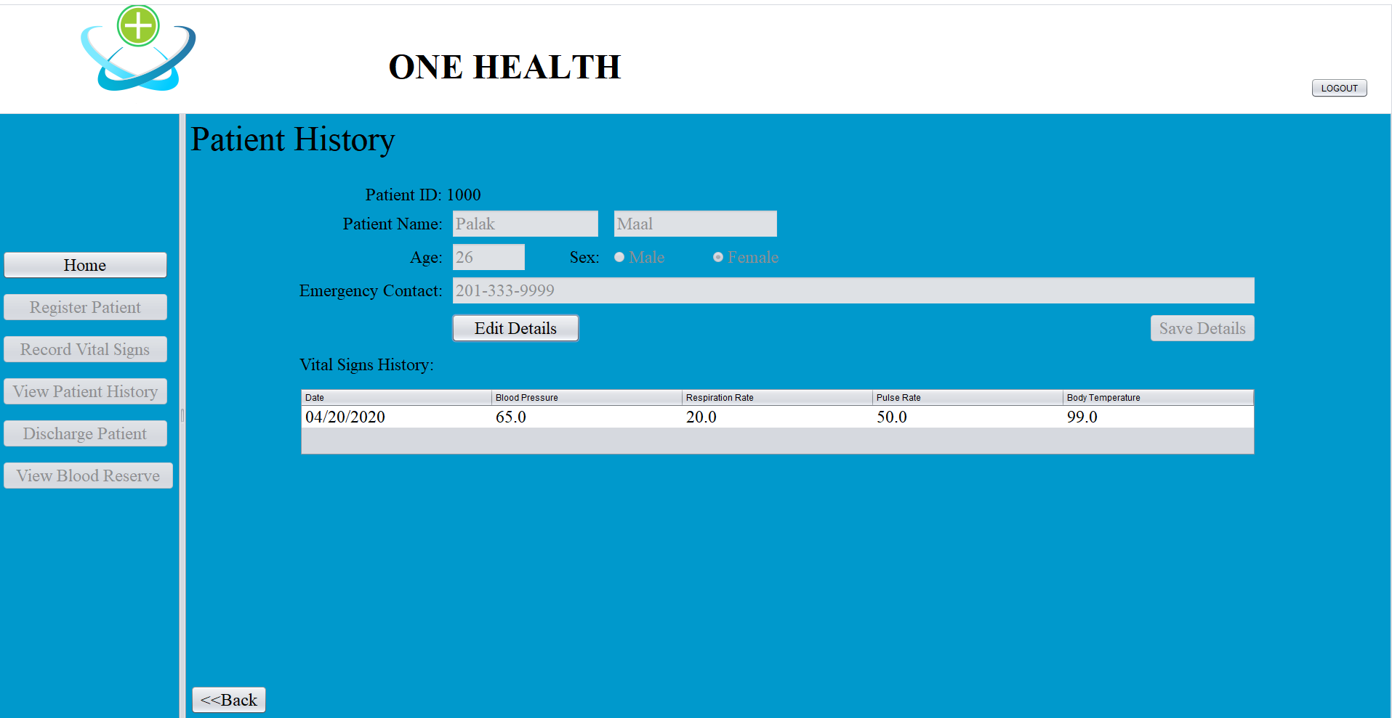

Slide 24
Supporting Enterprises
Equipment Supplier
Medicine Supplier
Blood Bank

Slide 25
Features
Employment
Donations
Doctor Schedule Display
Statistics Display
Suppliers’ reference

Slide 26
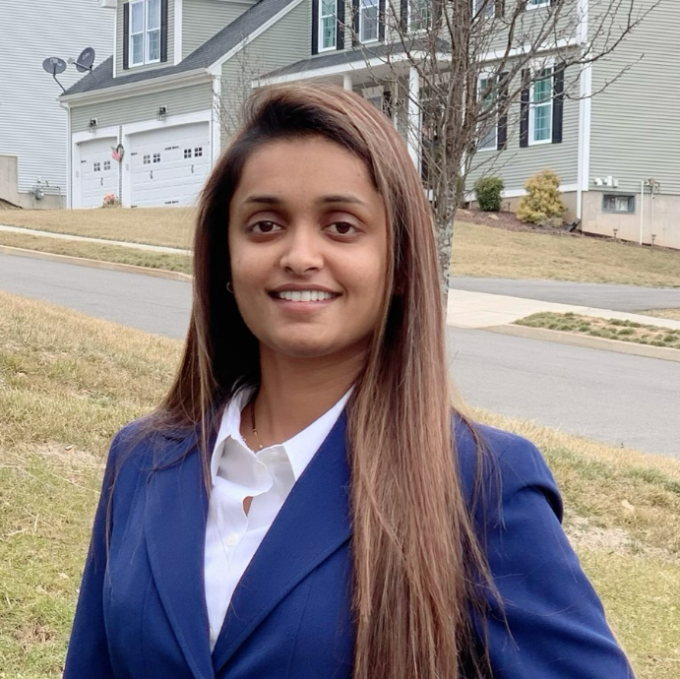

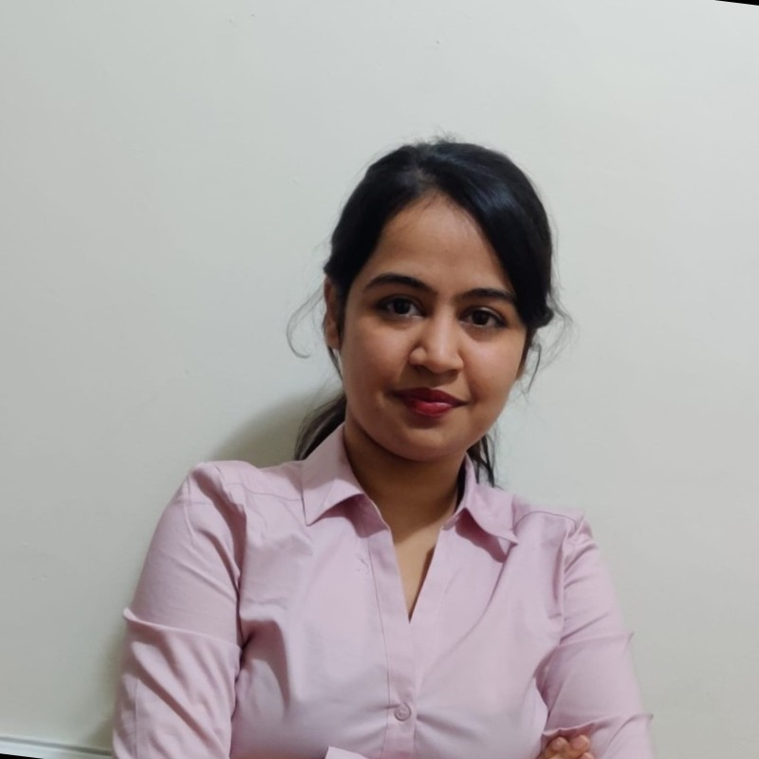
Team – GoCode
Monali Patel
Sylvester Noronha
Palak Maal
001044316
001028783
001062311

Slide 27
Thank You…!!!

